Slide 1
Chapter 4 Data-level Parallelism Vector,SIMD, and GPU

Slide 2
Data/Thread level Parallelism
Data level parallelism
Vector Processor
GPU
Thread level Parallelism
SMP/DSM
Cache coherence
Synchronization

Slide 3
SIMD
SIMD architectures can exploit significant data-level parallelism for:
Matrix-oriented scientific computing
Media-oriented image and sound processors
SIMD is more energy efficient than MIMD
Only needs to fetch one instruction per data operation
Makes SIMD attractive for personal mobile devices
SIMD allows programmer to continue to think sequentially

Slide 4
Alternative Model: Vector Processing
Vector processors have high-level operations that work on linear arrays of numbers: "vectors"
SCALAR
(1 operation)
VECTOR
(N operations)
r1
r2
v1
v2
+
+
r3
v3
vector
length
add r3, r1, r2
add.vv v3, v1, v2
Notes:
4
25
Vector processor is a CPU design that vector instruction can perform mathematical operations on a set of data elements simultaneously. This is in contrast to a scalar processor which handles one element at a time using multiple instructions.
Vector processors were common in the scientific computing area through the 1980s and into the 1990s, because scientific applications typically operate on arrays and matrices

Slide 5
Properties of Vector Processors
Single vector instruction implies lots of work (­ loop)
fewer instruction fetches
Each result independent of previous result
long pipeline, compiler ensures no dependencies
high clock rate
hardware does not have to check for data hazards
Vector instructions that access memory have a known access pattern.
highly interleaved memory
amortize memory latency of over ­ 64 elements
no (data) caches required!
Reduces branches and branch problems in pipelines
control hazards that would normally arise from the loop branch are nonexistent.
Notes:
Vector processors have the following properties.
Each single vector instruction implies a lot of work. In fact they can do the same work as a loop in scalar processor.
We will have much fewer instructions and instruction fetch.

Slide 6

Supercomputer vs. Vector Processor
CDC6600 (Cray, 1964) regarded as first commercial supercomputer.
In 70s-80s, Supercomputer ≡ Vector Machine
Seymour Cray
Father of supercomputing
Founder of company Cray Research
Seymour Cray
Notes:
CDC: Control Data Corporation
Vector processing was especially popularized by Cray in the 1970s and 1980s.

Slide 7
Types of Vector Architectures
memory-memory vector processors: all vector operations are memory to memory
CDC Star-100 (‘73) , TI ASC (’71)
vector-register processors: all vector operations between vector registers (except load and store)
Vector equivalent of load-store architectures
Cray-1(1976) was the 1st Vector-Register machine
Includes all vector machines since late 1980s: Cray, Convex, Fujitsu, Hitachi, NEC
We assume vector-register for rest of lectures
Notes:
7
For memory-memory vector processors, all the vector operations are memory to memory, which means or instruction operand the elements of the array are fetched from memory and the results are stored back to memory.
CDC Star-100 in 1973 and Texas Instrument ASC in 1971 are both m-m vector processors.

Slide 8
Vector-Register Architectures
Basic idea:
Read sets of data elements into “vector registers”
Operate on those registers
Disperse the results back into memory
Registers are controlled by compiler
Used to hide memory latency
Leverage memory bandwidth

Slide 9
Vector Memory-Memory vs. Vector-Register Machines
Vector Memory-Memory Code
Example Source Code
ADDV C, A, B
SUBV D, A, B
for (i=0; i<N; i++)
{
C[i] = A[i] + B[i];
D[i] = A[i] - B[i];
}
Vector Register Code
LV V1, A
LV V2, B
ADDV V3, V1, V2
SV V3, C
SUBV V4, V1, V2
SV V4, D

Slide 10
Vector Memory-Memory Achitecture
Vector memory-memory architectures (VMMA) require greater main memory bandwidth, why?
All operands must be read in and out of memory
VMMAs make if difficult to overlap execution of multiple vector operations, why?
Must check dependencies on memory addresses
VMMAs incur greater startup latency
Scalar code was faster on CDC Star-100 for vectors < 100 elements
For Cray-1, vector/scalar breakeven point was around 2 elements
We assume vector-register for rest of the lecture

Slide 11
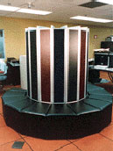
Cray-1 Breakthrough
Exquisite electrical and mechanical design
Semiconductor memory
Vector register concept
vast simplification of instruction set
reduced necc. memory bandwidth
Tight integration of vector and scalar
Piggy-back off 7600 stacklib
Later vectorizing compilers developed
Owned high-performance computing for a decade
what happened then?
VLIW competition

Slide 12
Cray-1 Block Diagram
Scalar Unit + Vector Extensions
Load/Store Architecture
Vector Registers
Simple 16-bit RR Vector Instructions(32-bit with immed)
Hardwired Control
Highly Pipelined Functional Units
Interleaved Memory System
No Data Caches
No Virtual Memory
V0
V_{i}
V. Mask
V1
V_{j}
64 Element Vector Registers
V2
V. Length
V3
V_{k}
Single Port
Memory
16 banks of 64-bit words
+
8-bit SECDED
80MW/sec data load/store
320MW/sec instruction
buffer refill
V4
V5
V6
V7
FP Add
S0
S_{j}
FP Mul
( (A_{h}) + j k m )
S1
S2
S_{k}
FP Recip
64
T Regs
S_{i}
S3
(A₀)
S4
S_{i}
Int Add
T_{jk}
S5
S6
Int Logic
S7
Int Shift
( (A_{h}) + j k m )
A0
Pop Cnt
A1
A_{i}
A2
A_{j}
(A₀)
64
B Regs
A3
A_{k}
Addr Add
B_{jk}
A4
A5
A_{i}
Addr Mul
A6
A7
64-bitx16
NIP
CIP
LIP
4 Instruction Buffers
memory bank cycle 50 ns processor cycle 12.5 ns (80MHz)

Slide 13
Components of Vector Processor
Vector Register: fixed length bank holding a single vector
has at least 2 read and 1 write ports
typically 8-32 vector registers, each holding 64-128 64-bit elements
Vector Functional Units (FUs): fully pipelined, start new operation every clock
Fully pipelined, start new operation every clock
Typically 4 to 8 FUs: FP add, FP mult, FP reciprocal (1/X), integer add, logical, shift;
may have multiple of same unit
Vector Load-Store Units (LSUs):
fully pipelined unit to load or store a vector;
Multiple elements fetched/stored per cycle
may have multiple LSUs
Scalar registers: single element for FP scalar or address
Cross-bar to connect FUs , LSUs, registers
Notes:
13

Slide 14
Basic Vector Instructions
Instr. Operands Operation Comment
ADDV V1,V2,V3 V1=V2+V3 vector + vector
ADDSV V1,F0,V2 V1=F0+V2 scalar + vector
MULTV V1,V2,V3 V1=V2xV3 vector x vector
MULSV V1,F0,V2 V1=F0xV2 scalar x vector
LV V1,R1 V1=M[R1..R1+63] load, stride=1
LVWS V1,R1,R2 V1=M[R1..R1+63*R2] load, stride=R2
LVI V1,R1,V2 V1=M[R1+V2i,i=0..63] indexed "gather"
CeqV VM,V1,V2 VMASKi = (V1i=V2i)? comp. setmask
MOV VLR,R1 Vec. Len. Reg. = R1 set vector length
MOV VM,R1 Vec. Mask = R1 set vector mask
+ all the regular scalar instructions (RISC style)…
Notes:
14

Slide 15
Vector Execution Time
Execution time depends on three factors:
Length of operand vectors
Structural hazards
Data dependencies
RV64V functional units consume one element per clock cycle
Execution time is approximately the vector length

Slide 16
Vector Memory operations
Load/store operations move groups of data between registers and memory
Three types of addressing
Unit stride
Fastest
Non-unit (constant) stride
Indexed (gather-scatter)
Vector equivalent of register indirect
Good for sparse arrays of data
Increases number of programs that vectorize
compress/expand variant also
Support for various combinations of data widths in memory
{.L,.W,.H.,.B} x {64b, 32b, 16b, 8b}

Slide 17
Vector Memory System
Cray-1, 16 banks, 4 cycle bank busy time, 12 cycle latency
Bank busy time: Cycles between accesses to same bank
Base
Stride
Vector Registers
Address Generator
+
0
1
2
3
4
5
6
7
8
9
A
B
C
D
E
F
Memory Banks

Slide 18
DAXPY (Y = a * X + Y)
Assuming vectors X, Y are length 64
Scalar vs. Vector
LD F0,a ;load scalar a
LV V1,Rx ;load vector X
MULTS V2,F0,V1 ;vector-scalar mult.
LV V3,Ry ;load vector Y
ADDV V4,V2,V3 ;add
SV Ry,V4 ;store the result
LD F0,a
ADDI R4,Rx,#512 ;last address to load
loop: LD F2, 0(Rx) ;load X(i)
MULTD F2,F0,F2 ;a*X(i)
LD F4, 0(Ry) ;load Y(i)
ADDD F4,F2, F4 ;a*X(i) + Y(i)
SD F4 ,0(Ry) ;store into Y(i)
ADDI Rx,Rx,#8 ;increment index to X
ADDI Ry,Ry,#8 ;increment index to Y
SUB R20,R4,Rx ;compute bound
BNZ R20,loop ;check if done
578 (2+9*64) vs. 321 (1+5*64) ops (1.8X)
578 (2+9*64) vs. 6 instructions (96X)
64 operation vectors + no loop overhead
also 64X fewer pipeline hazards

Slide 19
Vector Length
A vector register can hold some maximum number of elements for each data width (maximum vector length or MVL)
What to do when the application vector length is not exactly MVL?
Vector-length (VL) register controls the length of any vector operation, including a vector load or store
E.g. vadd.vv with VL=10 is
for (I=0; I<10; I++) V1[I]=V2[I]+V3[I]
VL can be anything from 0 to MVL
How do you code an application where the vector length is not known until run-time?

Slide 20
Strip Mining
Suppose application vector length > MVL
Strip mining
Generation of a loop that handles MVL elements per iteration
A set operations on MVL elements is translated to a single vector instruction
Example: vector daxpy of N elements
First loop handles (N mod MVL) elements, the rest handle MVL
VL = (N mod MVL); // set VL = N mod MVL
for (I=0; I<VL; I++) // 1st loop is a single set of
Y[I]=A*X[I]+Y[I]; // vector instructions
low = (N mod MVL);
VL = MVL; // set VL to MVL
for (I=low; I<N; I++) // 2nd loop requires N/MVL
Y[I]=A*X[I]+Y[I]; // sets of vector instructions

Slide 21
example for Strip Mining
Max Vector Length is fixed ！
for (i=0; i<N; i++)
C[i] = A[i]+B[i];
ANDI R1, N, #63 ; N mod 64
MTC1 VLR, R1 ; Do remainder
loop:
LV V1, RA
DSLL R2, R1, #3 ; Multiply by 8
DADDU RA, RA, R2 ; Bump pointer
LV V2, RB
DADDU RB, RB, R2
ADDV.D V3, V1, V2
SV V3, RC
DADDU RC, RC, R2
DSUBU N, N, R1 ; Subtract elements
LI R1, #64
MTC1 VLR, R1 ; Reset full length
BGTZ N, loop ; Any more to do?
A
B
C
+
Remainder
+
64 elements
+

Slide 22
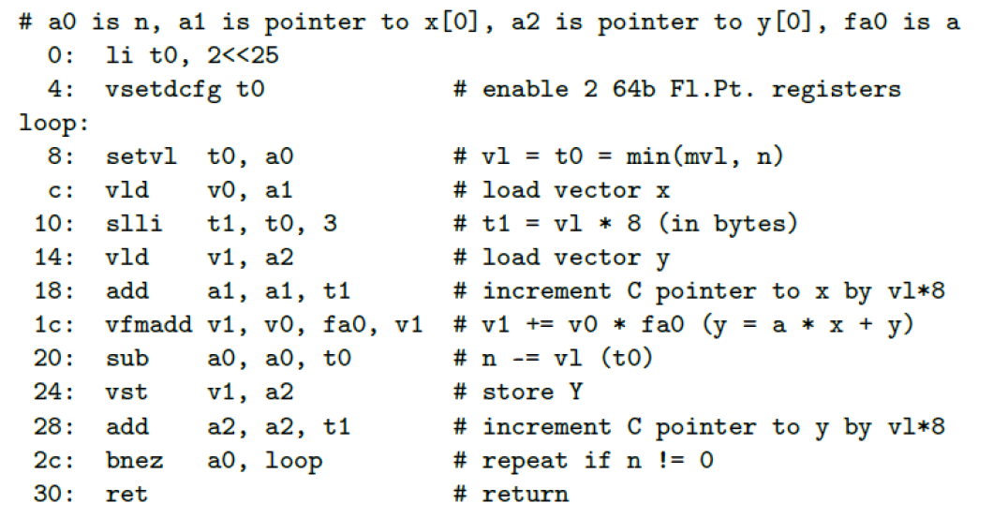
New in RISC V
MVL is decided by Hardware

Slide 23
Challenges
Start up time
Latency of vector functional unit
Assume the same as Cray-1
Floating-point add => 6 clock cycles
Floating-point multiply => 7 clock cycles
Floating-point divide => 20 clock cycles
Vector load => 12 clock cycles
Improvements:
> 1 element per clock cycle
Non-64 wide vectors
IF statements in vector code
Memory system optimizations to support vector processors
Multiple dimensional matrices
Sparse matrices
Programming a vector computer

Slide 24
Optimizing Vector Performance
Vector Chaining
Conditionally Executed Statements
Sparse Matrices
Multiple Lanes
Notes:
The first, chaining, deals with making a sequence of dependent vector operations run faster, and originated in the Cray-1 but is now supported on most vector processors. The next two deal with expanding the class of loops that can be run in vector mode by combating the effects of conditional execution and sparse matrices with new types of vector instruction. The fourth technique increases the peak performance of a vector machine by adding more parallel execution units in the form of additional lanes. The fifth technique reduces start-up overhead by pipelining and overlapping instruction start-up.

Slide 25
Optimization 1: Vector Chaining
the Concept of Forwarding Extended to Vector Registers
Vector version of register bypassing
introduced with Cray-1
V1
V2
V3
V4
V5
LV v1 A
MULV v3,v1,v2
ADDV v5, v3, v4
Chain
Chain
Load Unit
Mult.
Add
Memory

Slide 26
Vector Chaining Advantage
Without chaining, must wait for last element of result to be written into Vector register before starting dependent instruction
load
Mul
add
With chaining, can start dependent instruction as soon as first result appears
load
Mul
add

Slide 27
Convey & Chimes
Convey: Set of vector instructions that could potentially execute together
Chimes: Sequences with read-after-write dependency hazards placed in same convey via chaining
Chaining
Allows a vector operation to start as soon as the individual elements of its vector source operand become available
Chime
Unit of time to execute one convey
m conveys executes in m chimes for vector length n
For vector length of n, requires m x n clock cycles

Slide 28
Example (single mem access unit)
vld v0,x5 # Load vector X
vmul v1,v0,f0 # Vector-scalar multiply
vld v2,x6 # Load vector Y
vadd v3,v1,v2 # Vector-vector add
vst v3,x6 # Store the sum
Convoys:
1 vld vmul
2 vld vadd
3 vst
3 chimes, 2 FP ops per result, cycles per FLOP = 1.5
For 32 element vectors, requires 32 x 3 = 96 clock cycles

Slide 29
Optimization 2: Conditional Execution
Suppose you want to vectorize this: for (I=0; I<N; I++)
if (A[I]!= B[I]) A[I] -= B[I];
Solution: vector conditional execution
Add vector flag registers with single-bit elements
Use a vector compare to set the a flag register
Use flag register as mask control for the vector sub
Addition executed only for vector elements with corresponding flag element set
Vector code
vld V1, Ra
vld V2, Rb
vcmp.neq.vv F0, V1, V2 # vector compare
vsub.vv V3, V2, V1, F0 # conditional vadd
vst V3, Ra
RISCV:
Vpeq, Vpne, vplt, vpgt
Cray uses vector mask & merge

Slide 30
Masked Vector Instructions
Simple Implementation
execute all N operations, turn off result writeback according to mask
Density-Time Implementation
scan mask vector and only execute elements with non-zero masks
M[7]=1
A[7]
B[7]
M[6]=0
A[6]
B[6]
M[7]=1
M[5]=1
A[5]
B[5]
M[7]=1
M[6]=0
M[6]=0
A[7]
A[7]
B[7]
M[4]=1
A[4]
B[4]
B[7]
M[5]=1
M[3]=0
A[3]
B[3]
M[5]=1
M[4]=1
M[4]=1
C[5]
M[3]=0
C[5]
M[3]=0
M[2]=0
C[2]
M[2]=0
M[2]=0
C[4]
C[4]
M[1]=1
M[1]=1
C[1]
M[1]=1
M[0]=0
M[0]=0
C[1]
C[1]
M[0]=0
C[0]
Write data port
Write data port
Write Enable
Write data port

Slide 31
Compress/Expand Operations
Compress packs non-masked elements from one vector register contiguously at start of destination vector register
population count of mask vector gives packed vector length
Expand performs inverse operation
M[7]=1
A[7]
A[7]
A[7]
M[7]=1
M[6]=0
A[6]
A[5]
B[6]
M[6]=0
M[5]=1
A[5]
A[4]
A[5]
M[5]=1
M[4]=1
A[4]
A[1]
A[4]
M[4]=1
M[3]=0
A[3]
A[7]
B[3]
M[3]=0
M[2]=0
A[2]
A[5]
B[2]
M[2]=0
M[1]=1
A[1]
A[4]
A[1]
M[1]=1
M[0]=0
A[0]
A[1]
B[0]
M[0]=0
Compress
Expand
Used for density-time conditionals and also for general selection operations

Slide 32
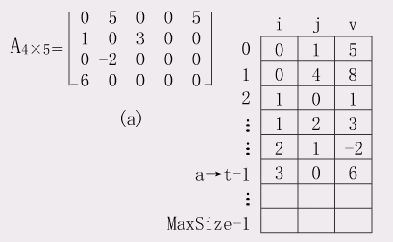
Optimization 3: sparce matrices

Slide 33
Indexed load （gather） vs indexed store （scatter）
vldx v0, a0, v1 vstx v0, a0, v1
V1
A0: 1024
Mem
V0
16
48
80
160
. .
. .
…
1024+16=1040
1024+48=1072
1024+80=1104
1024+160=1184

Slide 34
Vector Scatter/Gather
Want to vectorize loops with indirect accesses:
(index vector D designate the nonzero elements of C)
for (i=0; i<N; i++)
A[i] = B[i] + C[D[i]]
Indexed load instruction (Gather)
LV VD, RD ; Load indices in D vector
LVI VC,(RC, VD) ; Load indirect from RC base
LV VB, RB ; Load B vector
ADDV.D VA, VB, VC ; Do add
SV VA, RA ; Store result
Notes:
下标向量D表示C的非零元素。
The primary mechanism for supporting sparse matrices is scatter-gather operations using index vectors. 分散集中操作
The goal of such operations is to support moving between a dense representation (i.e., zeros are not included) and normal representation (i.e., the zeros are included) of a sparse matrix.
A gather operation takes an index vector and fetches the vector whose elements are at the addresses given by adding a base address to the offsets given in the index vector. The result is a nonsparse vector in a vector register.

Slide 35
Vector Scatter/Gather
Scatter example:
for (i=0; i<N; i++)
A[B[i]]++;
Is following a correct translation?
LV VB, RB ; Load indices in B vector
LVI VA,(RA, VB) ; Gather initial A values
ADDV VA, RA, 1 ; Increment
SVI VA,(RA, VB) ; Scatter incremented values
Notes:
After these elements are operated on in dense form, the sparse vector can be stored in expanded form by a scatter store, using the same index vector.

Slide 36
Optimization 4: Multi-lane Implementation
Pipelined
Datapath
Lane
Vector Reg.
Partition
Functional
Unit
To/From Memory System
Elements for vector registers interleaved across the lanes
Each lane receives identical control
Multiple element operations executed per cycle
Modular, scalable design
No need for inter-lane communication for most vector instructions

Slide 37
Multiple Lanes
ADDV C,A,B
Vector Instruction Execution
Execution using one pipelined functional unit
Execution using four pipelined functional units
A[6]
B[6]
A[24]
B[24]
A[25]
B[25]
A[26]
B[26]
A[27]
B[27]
A[5]
B[5]
A[20]
B[20]
A[21]
B[21]
A[22]
B[22]
A[23]
B[23]
A[4]
B[4]
A[16]
B[16]
A[17]
B[17]
A[18]
B[18]
A[19]
B[19]
A[3]
B[3]
A[12]
B[12]
A[13]
B[13]
A[14]
B[14]
A[15]
B[15]
C[2]
C[8]
C[9]
C[10]
C[11]
C[1]
C[4]
C[5]
C[6]
C[7]
C[0]
C[0]
C[1]
C[2]
C[3]
Notes:
The parallel semantics of a vector instruction allows an implementation to execute these elemental operations using :
either a deeply pipelined functional unit, or by using an array of parallel functional units, or a combination of parallel and pipelined functional units.
Using multiple functional units to improve the performance of a single vector add instruction
The machine shown in (a) has a single add pipeline and can complete one addition per cycle.
The machine shown in (b) has four add pipelines and can complete four additions per cycle.

Slide 38
Chain & Multiple Lane
Can overlap execution of multiple vector instructions
example machine has 32 elements per vector register and 8 lanes
Load Unit
Multiply Unit
Add Unit
load
mul
add
time
load
mul
add
Instruction issue
Complete 24 operations/cycle while issuing 1 short instruction/cycle

Slide 39
Two Ways to View Vectorization
Inner loop vectorization (Classic approach)
Think of machine as, say, 32 vector registers each with 16 elements
1 instruction updates 32 elements of 1 vector register
Good for vectorizing single-dimension arrays or regular kernels (e.g. saxpy)
Outer loop vectorization (post-CM2)
Think of machine as 16 “virtual processors” (VPs) each with 32 scalar registers! (­ multithreaded processor)
1 instruction updates 1 scalar register in 16 VPs
Good for irregular kernels or kernels with loop-carried dependences in the inner loop
These are just two compiler perspectives
The hardware is the same for both

Slide 40
Memory Banks
Memory system must be designed to support high bandwidth for vector loads and stores
Spread accesses across multiple banks
Control bank addresses independently
Load or store non sequential words (need independent bank addressing)
Support multiple vector processors sharing the same memory
Example:
32 processors, each generating 4 loads and 2 stores/cycle
Processor cycle time is 2.167 ns, SRAM cycle time is 15 ns
How many memory banks needed?
32x(4+2)x15/2.167 = ~1330 banks

Slide 41
Example Vector Machines
Machine Year Clock Regs Elements FUs LSUs
Cray 1 1976 80 MHz 8 64 6 1
Cray XMP 1983 120 MHz 8 64 8 2 L, 1 S
Cray YMP 1988 166 MHz 8 64 8 2 L, 1 S
Cray C-90 1991 240 MHz 8 128 8 4
Cray T-90 1996 455 MHz 8 128 8 4
Conv. C-1 1984 10 MHz 8 128 4 1
Conv. C-4 1994 133 MHz 16 128 3 1
Fuj. VP200 1982 133 MHz 8-256 32-1024 3 2
Fuj. VP300 1996 100 MHz 8-256 32-1024 3 2
NEC SX/2 1984 160 MHz 8+8K 256+var 16 8
NEC SX/3 1995 400 MHz 8+8K 256+var 16 8
Notes:
41
Cray 1; fastest scalar computer + 1st commercially successful vector computer, offered another 10X
6600 1st scoreboard
Cray XMP: 3 LSUs, Multiprocessor 4 way (not by Cray)
=> YMP, C-90, T-90; 2X processors, 1.5X clock
Cray 2 went to DRAM to get more memory, not so great
Like parallel teams as Intel (486, PPro, Pentium, next one)
Japan
Fujitsu, vary number of registers elements (8x1024 or 32x256)
NEC, 8x256 + 8K of varying elements

Slide 42
Vector Linpack Performance(MFLOPS)
Machine Year Clock 100x100 1kx1k Peak(Procs)
Cray 1 1976 80 MHz 12 110 160(1)
Cray XMP 1983 120 MHz 121 218 940(4)
Cray YMP 1988 166 MHz 150 307 2,667(8)
Cray C-90 1991 240 MHz 387 902 15,238(16)
Cray T-90 1996 455 MHz 705 1603 57,600(32)
Conv. C-1 1984 10 MHz 3 -- 20(1)
Conv. C-4 1994 135 MHz 160 2531 3240(4)
Fuj. VP200 1982 133 MHz 18 422 533(1)
NEC SX/2 1984 166 MHz 43 885 1300(1)
NEC SX/3 1995 400 MHz 368 2757 25,600(4)
Notes:
42
6X in 20 years; 32X in 20 years; Peak is 360X speedup
Weighed tons

Slide 43
Operation & Instruction Count: RISC v. Vector Processor
Spec92fp Operations (Millions) Instructions (M)
Program RISC Vector R / V RISC Vector R / V
swim256 115 95 1.1x 115 0.8 142x
hydro2d 58 40 1.4x 58 0.8 71x
nasa7 69 41 1.7x 69 2.2 31x
su2cor 51 35 1.4x 51 1.8 29x
tomcatv 15 10 1.4x 15 1.3 11x
wave5 27 25 1.1x 27 7.2 4x
mdljdp2 32 52 0.6x 32 15.8 2x
Vector reduces ops by 1.2X, instructions by 20X

Slide 44
Vector Advantages
Easy to get high performance; N operations:
are independent
use same functional unit
access disjoint registers
access registers in same order as previous instructions
access contiguous memory words or known pattern
can exploit large memory bandwidth
hide memory latency (and any other latency)
Scalable: (get higher performance by adding HW resources)
Compact: Describe N operations with 1 short instruction
Predictable: performance vs. statistical performance (cache)
Multimedia ready: N * 64b, 2N * 32b, 4N * 16b, 8N * 8b
Mature, developed compiler technology
Notes:
44
24
Why MPP? Best potential performance!
Few successes
Operator on vectors of registers
Its easier to vectorize than parallelize
Scales well: more hardware and slower clock rate
Crazy research

Slide 45
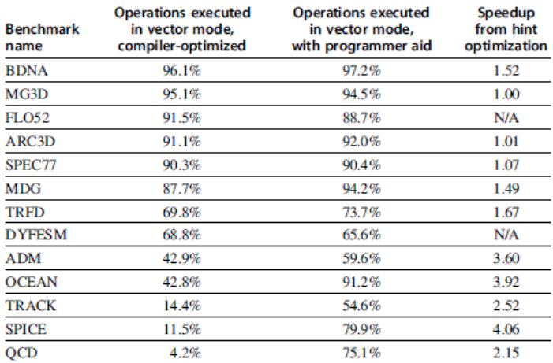
Programming Vec. Architectures
Compilers can provide feedback to programmers
Programmers can provide hints to compiler

Slide 46
Vector Pitfalls
Pitfall: Concentrating on peak performance and ignoring start-up overhead: N_{V} (length faster than scalar) > 100!
Pitfall: Increasing vector performance, without comparable increases in scalar performance (Amdahl's Law)
failure of Cray competitor (ETA) from his former company
Pitfall: Good processor vector performance without providing good memory bandwidth
MMX?

Slide 47
Vector Disadvantage: Out of Fashion?
Hard to say. Many irregular loop structures seem to still be hard to vectorize automatically.
Theory of some researchers that SIMD model has great potential.

Slide 48
SIMD Extensions
Media applications operate on data types narrower than the native word size
Example: disconnect carry chains to “partition” adder
Limitations, compared to vector instructions:
Number of data operands encoded into op code
No sophisticated addressing modes (strided, scatter-gather)
No mask registers

Slide 49
SIMD Implementations
Implementations:
Intel MMX (1996)
Eight 8-bit integer ops or four 16-bit integer ops
Streaming SIMD Extensions (SSE) (1999)
Eight 16-bit integer ops
Four 32-bit integer/fp ops or two 64-bit integer/fp ops
Advanced Vector Extensions (2010)
Four 64-bit integer/fp ops
AVX-512 (2017)
Eight 64-bit integer/fp ops
Operands must be consecutive and aligned memory locations

Slide 50
Example SIMD Code
Example DXPY:
fld f0,a # Load scalar a
splat.4D f0,f0 # Make 4 copies of a
addi x28,x5,#256 # Last address to load
Loop: fld.4D f1,0(x5) # Load X[i] ... X[i+3]
fmul.4D f1,f1,f0 # a x X[i] ... a x X[i+3]
fld.4D f2,0(x6) # Load Y[i] ... Y[i+3]
fadd.4D f2,f2,f1 # a x X[i]+Y[i]...
# a x X[i+3]+Y[i+3]
fsd.4D f2,0(x6) # Store Y[i]... Y[i+3]
addi x5,x5,#32 # Increment index to X
addi x6,x6,#32 # Increment index to Y
bne x28,x5,Loop # Check if done

Slide 51
Graphical Processing Units
Basic idea:
Heterogeneous execution model
CPU is the host, GPU is the device
Develop a C-like programming language for GPU
Unify all forms of GPU parallelism as CUDA thread
Programming model is “Single Instruction Multiple Thread”

Slide 52
Threads and Blocks
A thread is associated with each data element
Threads are organized into blocks
Blocks are organized into a grid
GPU hardware handles thread management, not applications or OS

Slide 53
NVIDIA GPU Architecture
Similarities to vector machines:
Works well with data-level parallel problems
Scatter-gather transfers
Mask registers
Large register files
Differences:
No scalar processor
Uses multithreading to hide memory latency
Has many functional units, as opposed to a few deeply pipelined units like a vector processor

Slide 54
Example
Code that works over all elements is the grid
Thread blocks break this down into manageable sizes
512 threads per block
SIMD instruction executes 32 elements at a time
Thus grid size = 16 blocks
Block is analogous to a strip-mined vector loop with vector length of 32
Block is assigned to a multithreaded SIMD processor by the thread block scheduler
Current-generation GPUs have 7-15 multithreaded SIMD processors

Slide 55
Terminology
Each thread is limited to 64 registers
Groups of 32 threads combined into a SIMD thread or “warp”
Mapped to 16 physical lanes
Up to 32 warps are scheduled on a single SIMD processor
Each warp has its own PC
Thread scheduler uses scoreboard to dispatch warps
By definition, no data dependencies between warps
Dispatch warps into pipeline, hide memory latency
Thread block scheduler schedules blocks to SIMD processors
Within each SIMD processor:
32 SIMD lanes
Wide and shallow compared to vector processors

Slide 56
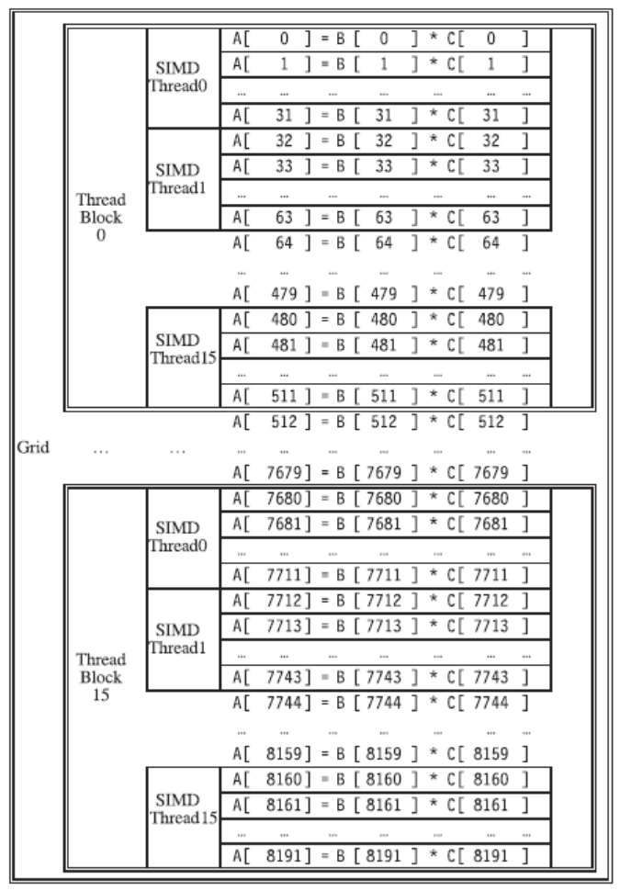
Example

Slide 57
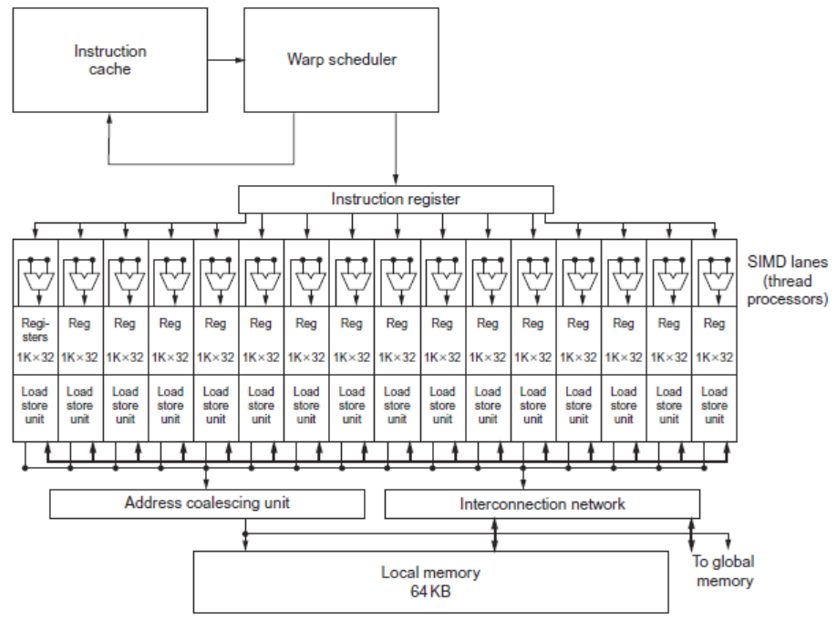
GPU Organization

Slide 58
NVIDIA Instruction Set Arch.
ISA is an abstraction of the hardware instruction set
“Parallel Thread Execution (PTX)”
opcode.type d,a,b,c;
Uses virtual registers
Translation to machine code is performed in software
Example:
shl.s32 R8, blockIdx, 9 ; Thread Block ID * Block size (512 or 29)
add.s32 R8, R8, threadIdx ; R8 = i = my CUDA thread ID
ld.global.f64 RD0, [X+R8] ; RD0 = X[i]
ld.global.f64 RD2, [Y+R8] ; RD2 = Y[i]
mul.f64 RD0, RD0, RD4 ; Product in RD0 = RD0 * RD4 (scalar a)
add.f64 RD0, RD0, RD2 ; Sum in RD0 = RD0 + RD2 (Y[i])
st.global.f64 [Y+R8], RD0 ; Y[i] = sum (X[i]*a + Y[i])

Slide 59
Conditional Branching
Like vector architectures, GPU branch hardware uses internal masks
Also uses
Branch synchronization stack
Entries consist of masks for each SIMD lane
I.e. which threads commit their results (all threads execute)
Instruction markers to manage when a branch diverges into multiple execution paths
Push on divergent branch
…and when paths converge
Act as barriers
Pops stack
Per-thread-lane 1-bit predicate register, specified by programmer

Slide 60
Example
if (X[i] != 0)
X[i] = X[i] – Y[i];
else X[i] = Z[i];
ld.global.f64 RD0, [X+R8] ; RD0 = X[i]
setp.neq.s32 P1, RD0, #0 ; P1 is predicate register 1
@!P1, bra ELSE1, *Push ; Push old mask, set new mask bits
; if P1 false, go to ELSE1
ld.global.f64 RD2, [Y+R8] ; RD2 = Y[i]
sub.f64 RD0, RD0, RD2 ; Difference in RD0
st.global.f64 [X+R8], RD0 ; X[i] = RD0
@P1, bra ENDIF1, *Comp ; complement mask bits
; if P1 true, go to ENDIF1
ELSE1: ld.global.f64 RD0, [Z+R8] ; RD0 = Z[i]
st.global.f64 [X+R8], RD0 ; X[i] = RD0
ENDIF1: <next instruction>, *Pop ; pop to restore old mask

Slide 61
NVIDIA GPU Memory Structures
Each SIMD Lane has private section of off-chip DRAM
“Private memory”
Contains stack frame, spilling registers, and private variables
Each multithreaded SIMD processor also has local memory
Shared by SIMD lanes / threads within a block
Memory shared by SIMD processors is GPU Memory
Host can read and write GPU memory

Slide 62
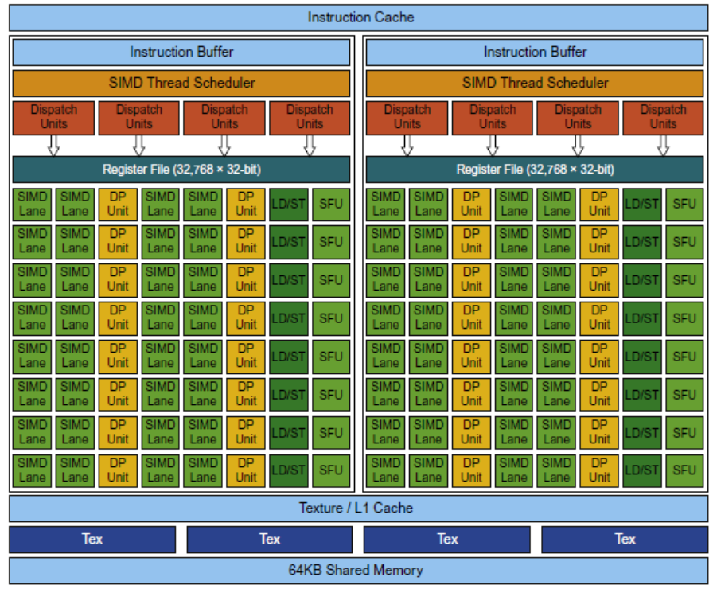
Pascal Multithreaded SIMD Proc.

Slide 63
Vector Architectures vs GPUs
SIMD processor analogous to vector processor, both have MIMD
Registers
RV64V register file holds entire vectors
GPU distributes vectors across the registers of SIMD lanes
RV64 has 32 vector registers of 32 elements (1024)
GPU has 256 registers with 32 elements each (8K)
RV64 has 2 to 8 lanes with vector length of 32, chime is 4 to 16 cycles
SIMD processor chime is 2 to 4 cycles
GPU vectorized loop is grid
All GPU loads are gather instructions and all GPU stores are scatter instructions

Slide 64
SIMD Architectures vs GPUs
GPUs have more SIMD lanes
GPUs have hardware support for more threads
Both have 2:1 ratio between double- and single-precision performance
Both have 64-bit addresses, but GPUs have smaller memory
SIMD architectures have no scatter-gather support

Slide 65
Loop-Level Parallelism
Focuses on determining whether data accesses in later iterations are dependent on data values produced in earlier iterations
Loop-carried dependence
Example 1:
for (i=999; i>=0; i=i-1)
x[i] = x[i] + s;
No loop-carried dependence

Slide 66
Loop-Level Parallelism
Example 2:
for (i=0; i<100; i=i+1) {
A[i+1] = A[i] + C[i]; /* S1 */
B[i+1] = B[i] + A[i+1]; /* S2 */
}
S1 and S2 use values computed by S1 in previous iteration
S2 uses value computed by S1 in same iteration

Slide 67
Loop-Level Parallelism
Example 3:
for (i=0; i<100; i=i+1) {
A[i] = A[i] + B[i]; /* S1 */
B[i+1] = C[i] + D[i]; /* S2 */
}
S1 uses value computed by S2 in previous iteration but dependence is not circular so loop is parallel
Transform to:
A[0] = A[0] + B[0];
for (i=0; i<99; i=i+1) {
B[i+1] = C[i] + D[i];
A[i+1] = A[i+1] + B[i+1];
}
B[100] = C[99] + D[99];

Slide 68
Loop-Level Parallelism
Example 4:
for (i=0;i<100;i=i+1) {
A[i] = B[i] + C[i];
D[i] = A[i] * E[i];
}
Example 5:
for (i=1;i<100;i=i+1) {
Y[i] = Y[i-1] + Y[i];
}

Slide 69
Finding dependencies
Assume indices are affine:
a x i + b (i is loop index)
Assume:
Store to a x i + b, then
Load from c x i + d
i runs from m to n
Dependence exists if:
Given j, k such that m ≤ j ≤ n, m ≤ k ≤ n
Store to a x j + b, load from a x k + d, and a x j + b = c x k + d

Slide 70
Finding dependencies
Generally cannot determine at compile time
Test for absence of a dependence:
GCD test:
If a dependency exists, GCD(c,a) must evenly divide (d-b)
Example:
for (i=0; i<100; i=i+1) {
X[2*i+3] = X[2*i] * 5.0;
}

Slide 71
Finding dependencies
Example 2:
for (i=0; i<100; i=i+1) {
Y[i] = X[i] / c; /* S1 */
X[i] = X[i] + c; /* S2 */
Z[i] = Y[i] + c; /* S3 */
Y[i] = c - Y[i]; /* S4 */
}
Watch for antidependencies and output dependencies

Slide 72
Reductions
Reduction Operation:
for (i=9999; i>=0; i=i-1)
sum = sum + x[i] * y[i];
Transform to…
for (i=9999; i>=0; i=i-1)
sum [i] = x[i] * y[i];
for (i=9999; i>=0; i=i-1)
finalsum = finalsum + sum[i];
Do on p processors:
for (i=999; i>=0; i=i-1)
finalsum[p] = finalsum[p] + sum[i+1000*p];
Note: assumes associativity!

Slide 73
Fallacies and Pitfalls
GPUs suffer from being coprocessors
GPUs have flexibility to change ISA
Concentrating on peak performance in vector architectures and ignoring start-up overhead
Overheads require long vector lengths to achieve speedup
Increasing vector performance without comparable increases in scalar performance
You can get good vector performance without providing memory bandwidth
On GPUs, just add more threads if you don’t have enough memory performance

